Slide 1
How might we help disadvantaged youth and young professionals gain the skills by organizations to gain a job?
Notes:
We have the honor to have been matched to an amazing project with Bloomberg and strive to make a real change to the lives of millions of people: How might we help disadvantaged youth and young professionals gain the skills required to get a job

Slide 2
Michael Capozzi
Mike Huang
Vincent
Kuo
Yi
Tang
Andy
Wei
Notes:
This is the team but as much as we can talk about ourselves, this is not about us…

Slide 3
Willy
22 year old
Low-income Mexican family
Unemployed college graduate
Want to be an engineer
“I would really like to have someone to guide me to enter the industry”
Notes:
This is about Willy. We met Willy a few days ago and had the pleasure of speaking with him about his life, his background, his motivations and aspirations.
And now I ask you (raise your hands)… how many of you have had the opportunity to have a mentor, a family member, a friend guide you through your career? How many have had the chance to go to schools that give you the tools you need – hard skills or soft skills - in order to get employment? Whether you raised your hand or not, if you are seating here in this beautiful campus, in one way or another, you have had that opportunity. But what shouldn’t surprise you is that out there, there is world that instead of lifting you up, it’s adamant to bring you down. Willy is one of these: a 22 year old, from a low income family… and who wants to be a an engineer but he suffers to many pain points:
He cannot find mentors that can guide him and teach him about what is required to get a job
No one taught him the soft skills required to interview successfully
He has no clue which skills are required to be an engineer
Connecting with people that share the same background and goals
But this is not only the story of Willy….

Slide 4
Notes:
This is the story of thousands of disadvantaged youth and young professionals in New York City

Slide 5
In NYC…
44.2%
in or near poverty line in NYC
15.2%
of 18-26 year old are not enrolled in school or working
Notes:
In NYC, almost half of the total population in NYC lives in or near the poverty line in NYC. Most live with only 18 dollars a day to cover everything In their lives: food, housing, etc. To put it into perspective, only think that the minimum wage is $7.25 an hour, which is about $58 a day.
In NYC as well, about 15% of 18-26 year olds are not enrolled in school and no working, but looking for employment. That doesn’t account for the thousands of stories of young people that are in low-skill jobs – super, grocery clerks, among others – that want to be in better jobs and simply don’t get the chance.

Slide 6
Why STEM?
85%
Growth in number of STEM jobs
48%
above average annual salary
2.1B+
investment in STEM education and jobs
Notes:
So, we’ll attack this by focusing first on STEM careers because it is undoubtedly, where we see the most potential for our product to be a catalyst of change. The growth in number of jobs in NYC is exponential and continues to grow year over year, the wages are way above average and public and private investment in STEM education is in the billions! That’s for New York state as a whole, but sitting here today at Cornell Tech, this investment in STEM shouldn’t surprise you
Average growth rate for jobs – 11.3%
NY State is second in the nation in STEM spending

Slide 7
A long learning journey with with full of obstacles.
Discover
Goal
Plan
Learn
Job
Notes:
But how does our user get there… well, the journey is difficult and full of pain points. They first ”discover” their career, but that in itself is not easy because many youth and young professionals and disadvantaged households don’t have the opportunity to even dream much. They may set goals that are unrealistic or that it might be too costly to pursue and fail before even getting started. They set a plan, when they can, bust most of the time they don’t know what it takes to get where they want to. And ultimately they learn the skills and get a job.
Our focus is the learning process, which based on our research, it is the most difficult part for our user to get through. Just like Willy, they have problems with even knowing what they should learn, practicing the soft skills that are needed in their professional lives such as interview prep, resume building and also and more importantly, access to mentors that care about their well-being, that want to help and want to pass on their knowledge.

Slide 8
Find
the resources YOU need to build your SKILLS
Learn
Connect
with mentors, support groups and events to build your network and learns from others
Engage
with others in your community and pass on the learnings
Notes:
Our purpose is to help them:
Find the resources they need
Connect with people, events, mentors that can help them learn and guide them in their way
And engage with others in the community to continue passing these learnings

Slide 9
Our goal is to match our user to mentors that can help them to gain the skills required by companies
Mentors
Product
Users
Professionals
“Buddy” app
Disadvantaged youth / Young professionals
Matching
Knowledge / Skills
Mentoring
Work Experience
Interview Practice
Career Path / Exploration / Events
Job requirements
Resume Building
Interview / Portfolio preparation

Slide 10
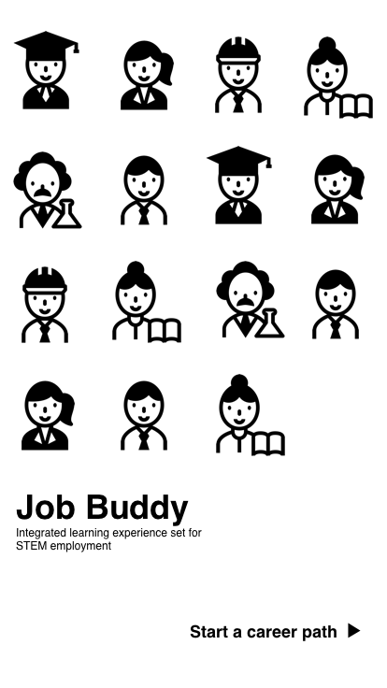

Slide 11
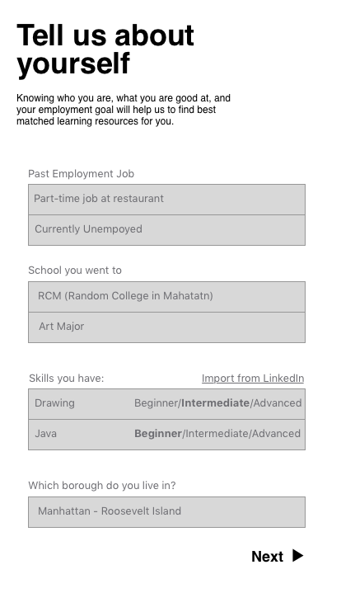

Slide 12
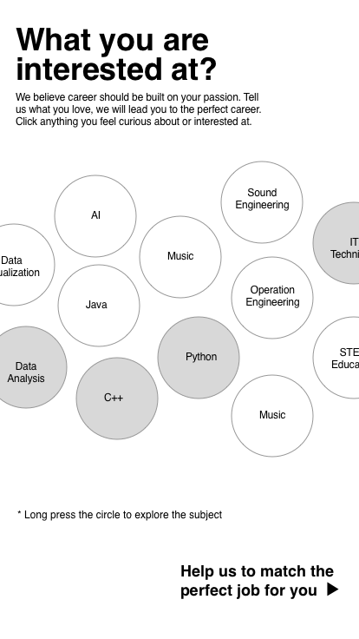

Slide 13
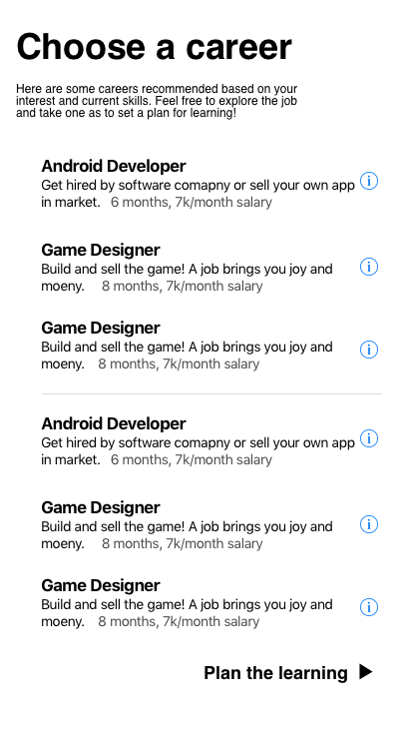

Slide 14
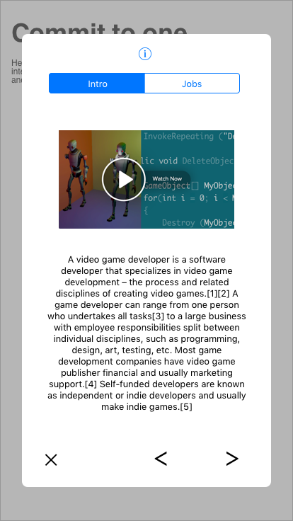

Slide 16
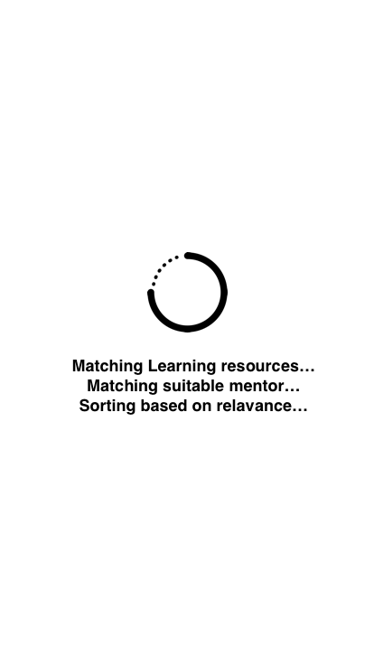

Slide 17
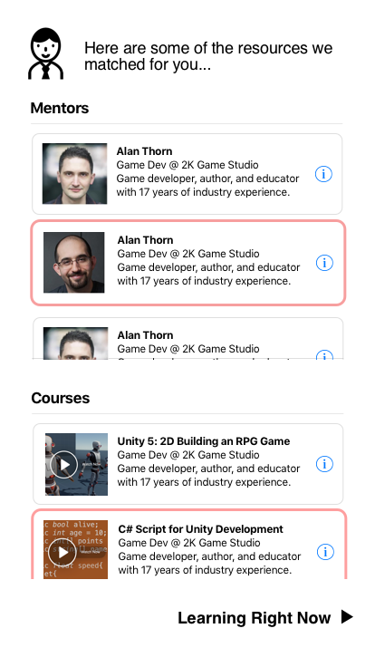

Slide 18
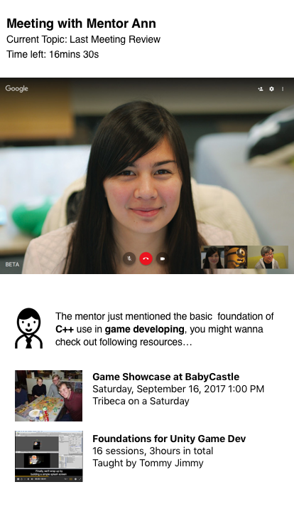

Slide 19
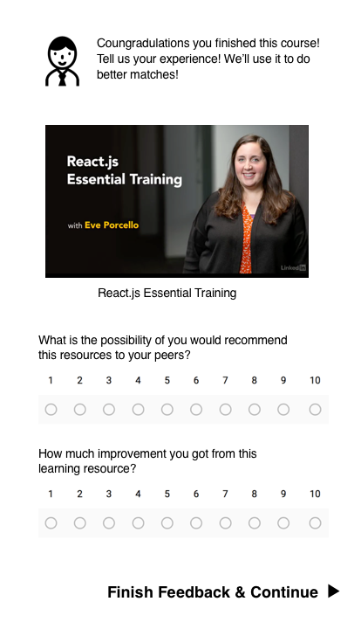

Slide 20
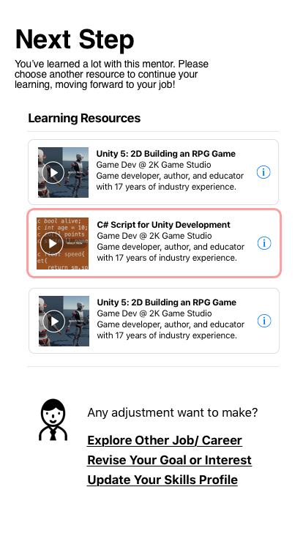

Slide 21
Next Steps
Continue to perform user research
Validate our initial product construct
Explore technical feasibility
Iterate, iterate, iterate

Slide 22
Questions?

